Slide 1
Meeting 9 March 2023

Slide 2
























PGM so far – Fleeing from Local Minima on Big Loops (Gaps)
BEFORE
TRY1 – Matrix Mul + cnn: Force to focus in more important regions
TRY2 – Matrix Mul + cnn + upsampling: Same goal as TRY1
$$x$$
$$x$$
$$x$$
$$𝒯_{γ}^{−1}\left(x\right)$$
$$𝒯_{γ}^{−1}\left(x\right)$$
$$𝒯_{γ}^{−1}\left(x\right)$$
$$z_{1}$$
$$z_{2}$$
$$z_{2}$$
$$z_{2}$$
Pretrained
$$z_{1}$$
$$ψ$$
Pretrained
$$γ$$
Pretrained
$$γ$$
$$\tilde{x}$$
$$\tilde{x}$$
$$\tilde{x}$$
$$γ$$
$𝒯_{γ}$ $\left(\tilde{x} \right)$
$𝒯_{γ}$ $\left(\tilde{x} \right)$
$𝒯_{γ}$ $\left(\tilde{x} \right)$
$$\overline{x}$$
$$\overline{x}$$
$$\overline{x}$$

Slide 3
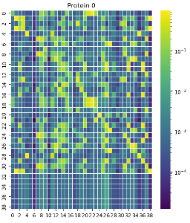







PGM so far – Fleeing from Local Minima on Big Loops (Gaps)
TRY1 – Matrix Mul + cnn: Force to focus in more important regions
$$x$$
$$ψ=x ∗MC(θ)$$
$$𝒯_{γ}^{−1}\left(x\right)$$
$$z_{2}$$
$$z_{1}$$
$$ψ$$
Pretrained
$$\tilde{x}$$
$$z_{1}$$
$$θ$$
$$γ$$
$𝒯_{γ}$ $\left(\tilde{x} \right)$
$$\overline{x}$$

Slide 4






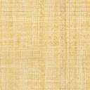




PGM so far – Fleeing from Local Minima on Big Loops (Gaps)
TRY1 – Matrix Mul + cnn: Force to focus in more important regions
$$x$$
$$𝒯_{γ}^{−1}\left(x\right)$$
$$ψ=x ∗MC(θ)$$
$$z_{2}$$
$$γ$$
Pretrained
$$\tilde{x}$$
$$θ$$
$𝒯_{γ}$ $\left(\tilde{x} \right)$
$$γ$$
$$\overline{x}$$

Slide 5




Feature Extractor por infering $γ$
$$x$$
Matrix Mul
$$γ$$
$$z_{2}$$
MC Sampling
(100 iters)
Pretrained
$$\tilde{x}$$
CNN: (c_in:39, c_out: 10, kernel: 14) + LeakyRelu(0.5)
Linear: (in: L_upsamp, out: tess cells)
CNN: (c_in:10, c_out: 5, kernel: 14) + LeakyRelu(0.5)
Upsampling-deconv: (c_in:15, c_out: 28, kernel: 30) + LeakyRelu(0.5)
Upsampling-deconv: (c_in:5, c_out: 15, kernel: 30) + LeakyRelu(0.5)

Slide 6
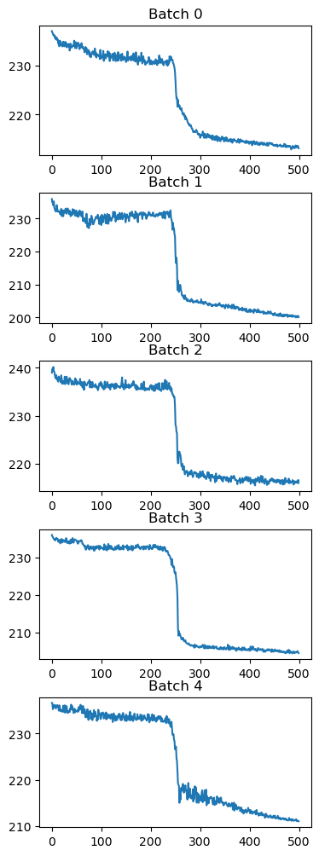
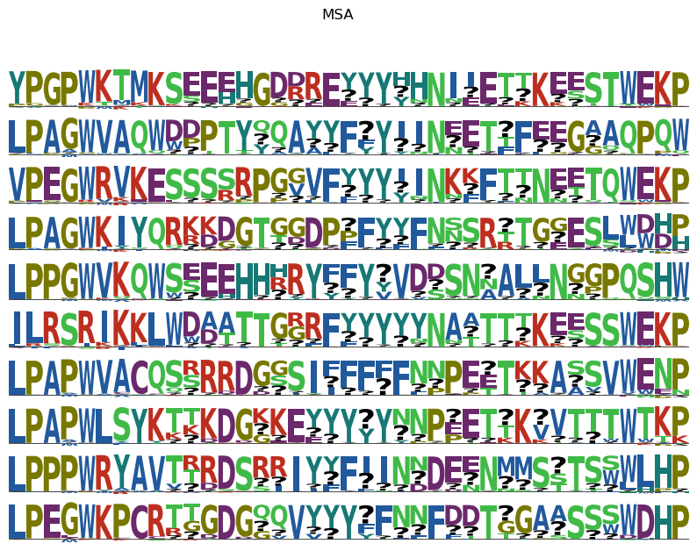

Slide 7
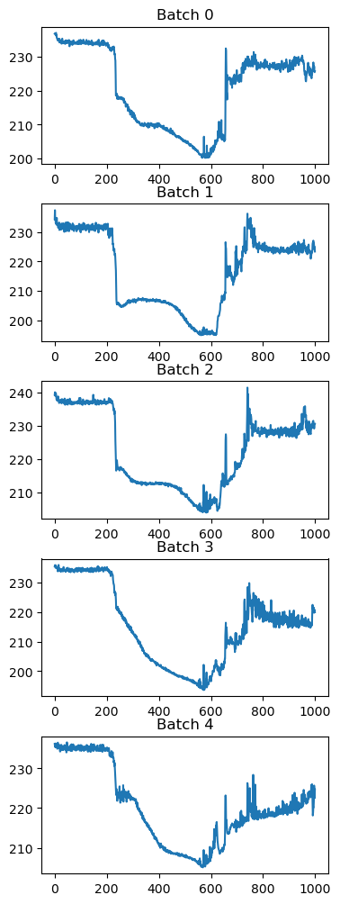
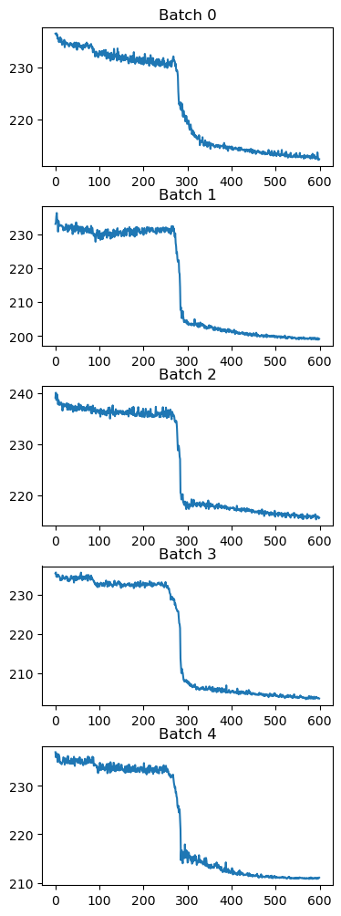
500 iters, slope:0.5
1000 iters, slope:0.5
600 iters, slope:0.1
1000 iters, slope:0.1
RUNNING!!! (see reproducible result)

Slide 8
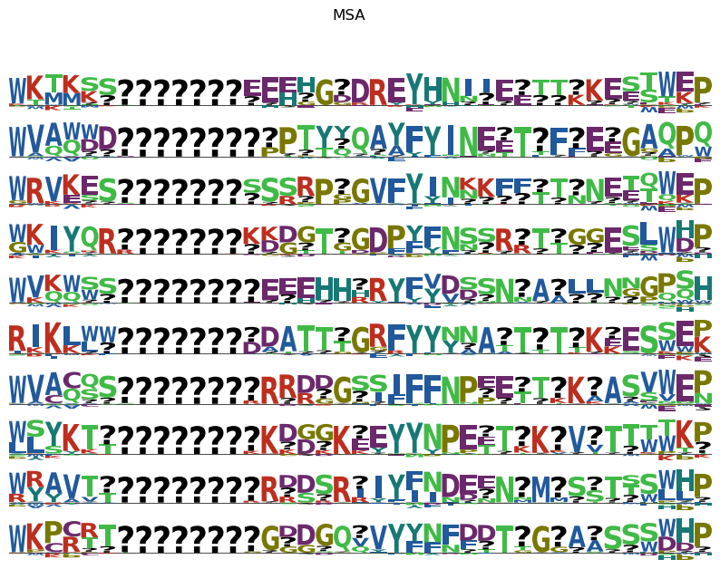

Slide 9
NEW ARCHITECTURE

Slide 10
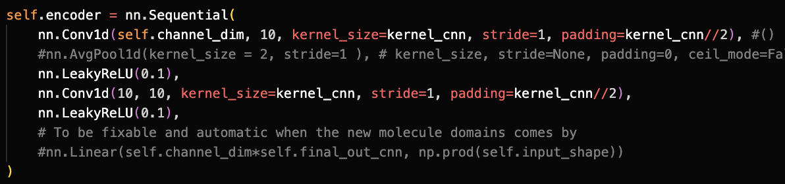
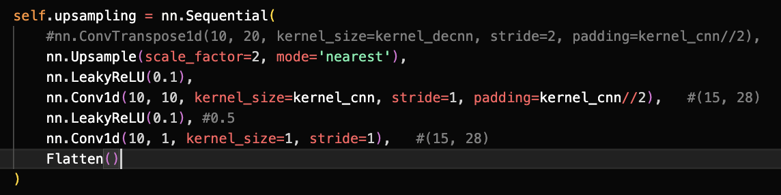
Feature Extractor por infering $γ$
$$x$$
Matrix Mul
$$γ$$
$$z_{2}$$
MC Sampling
(100 iters)
Pretrained
$$\tilde{x}$$

Slide 11
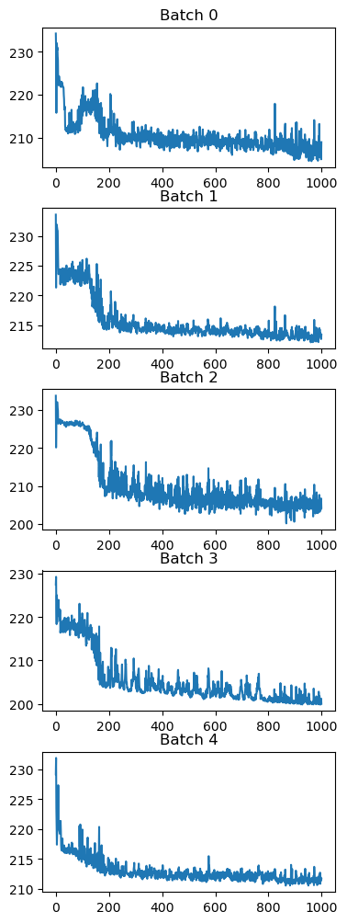
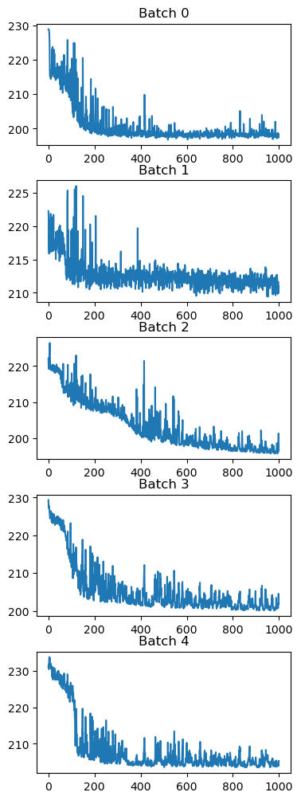
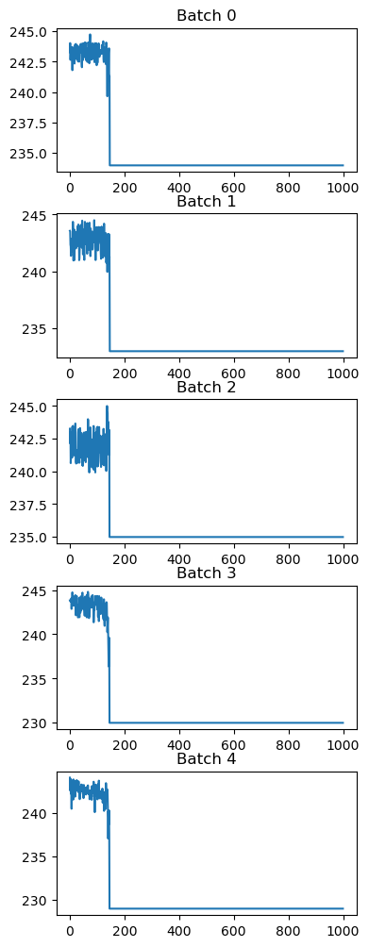
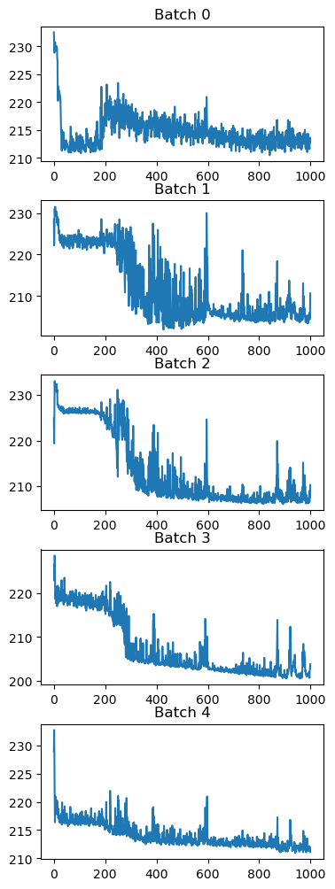
LR=1E-3, cnn-UPSAMPLING, kernel_size= 11
LR=1E-3, cnn-UPSAMPLING, kernel_size= 15
Nearest
Linear
Nearest
Linear

Slide 12
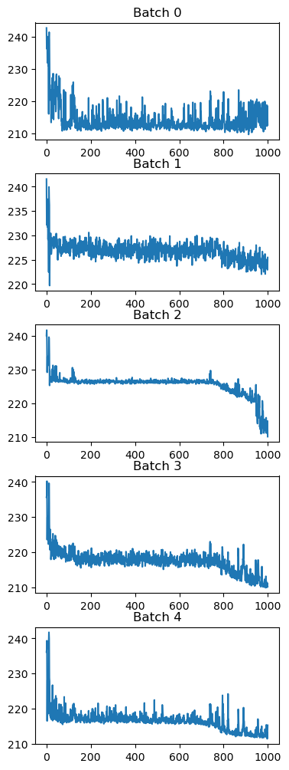
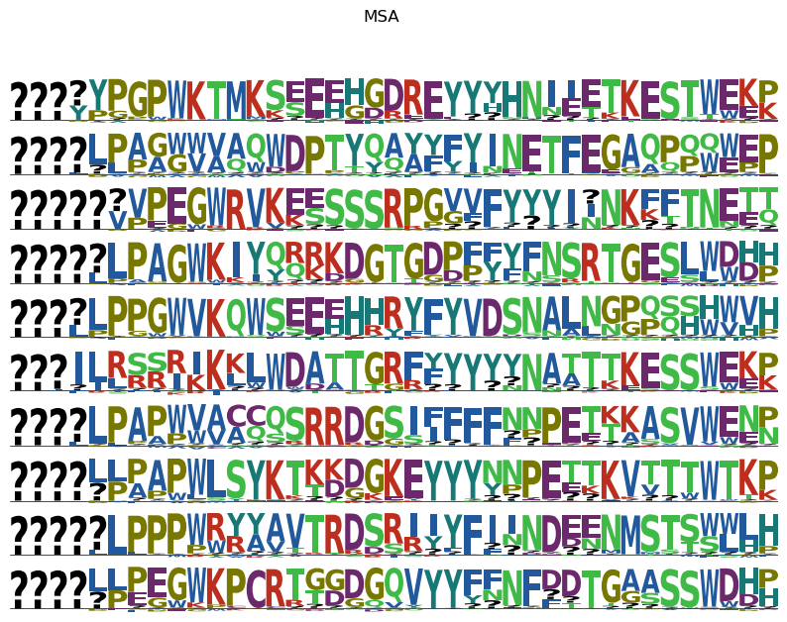
Is something happening here?, why is it going down after iter 800?

Slide 13
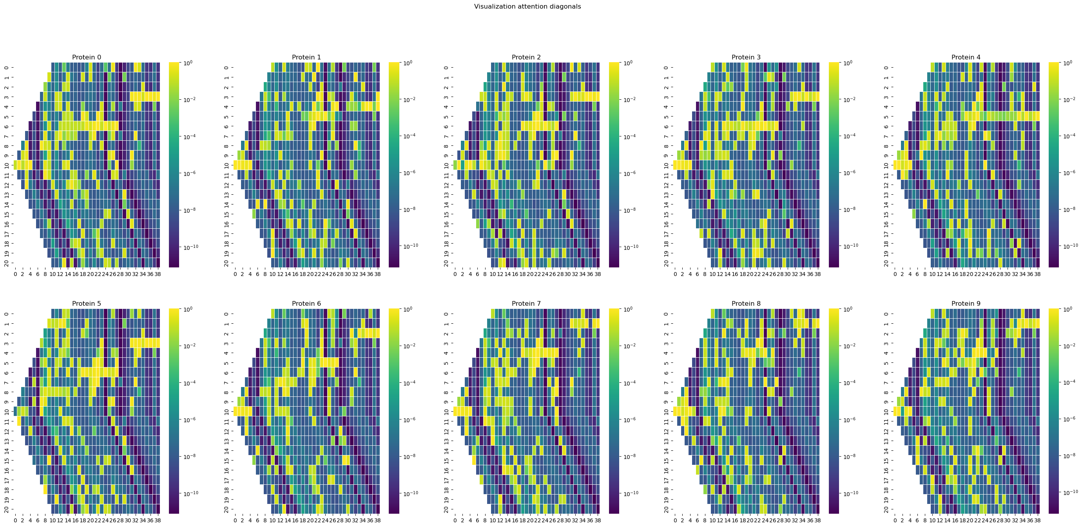
BEFORE – MULTIPLICATION( RAW DEEP, SEQUENCE => PRETRAINED WITH 10 SEQUENCE)

Slide 14
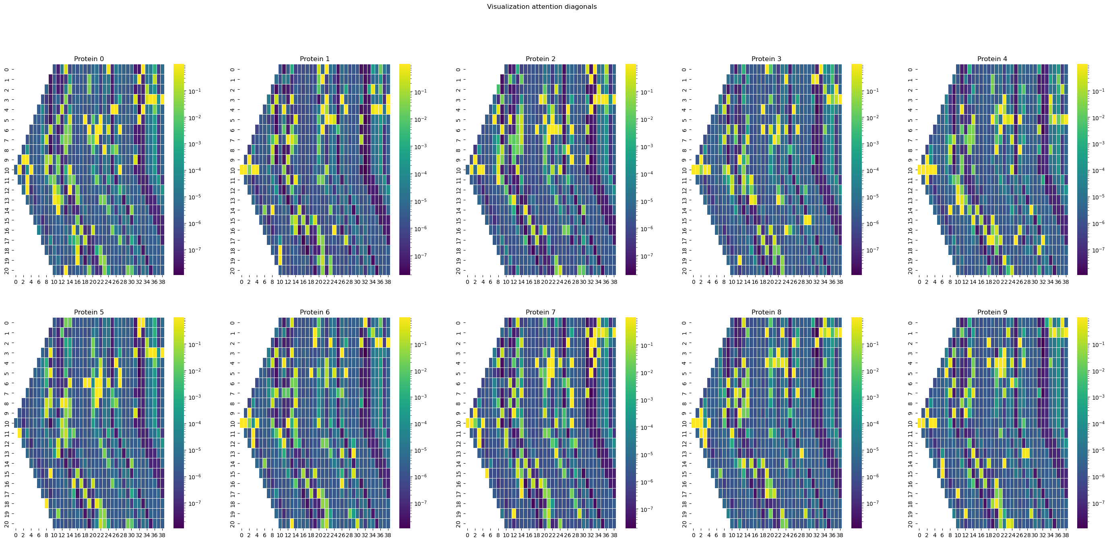
BEFORE – MULTIPLICATION( RAW DEEP, SEQUENCE => PRETRAINED WITH 100 SEQUENCE)

Slide 15
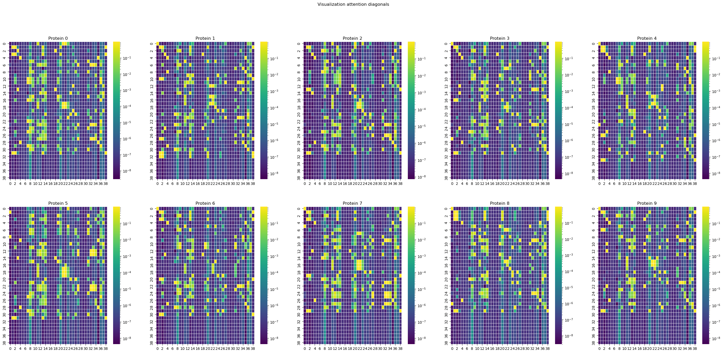

Slide 16
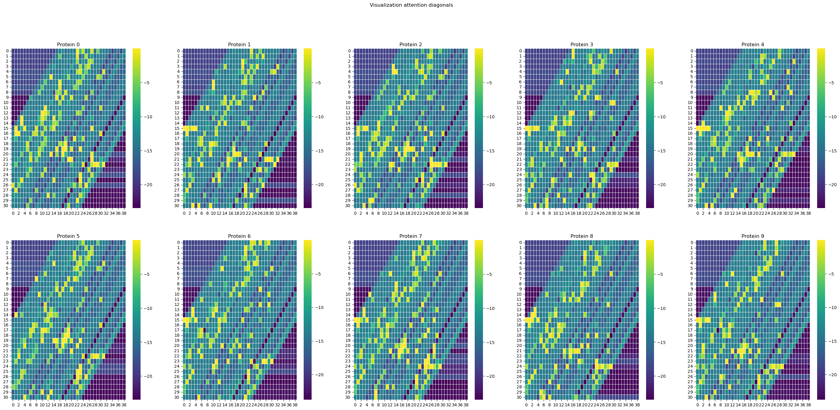
SO FAR – 24 March 2023

Slide 17
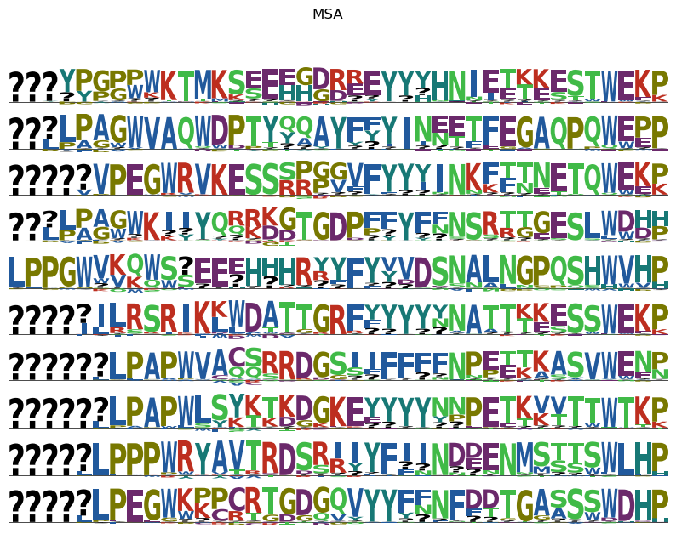
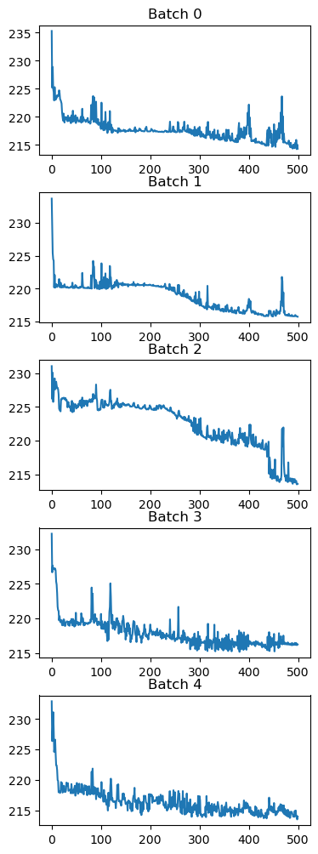

Slide 18
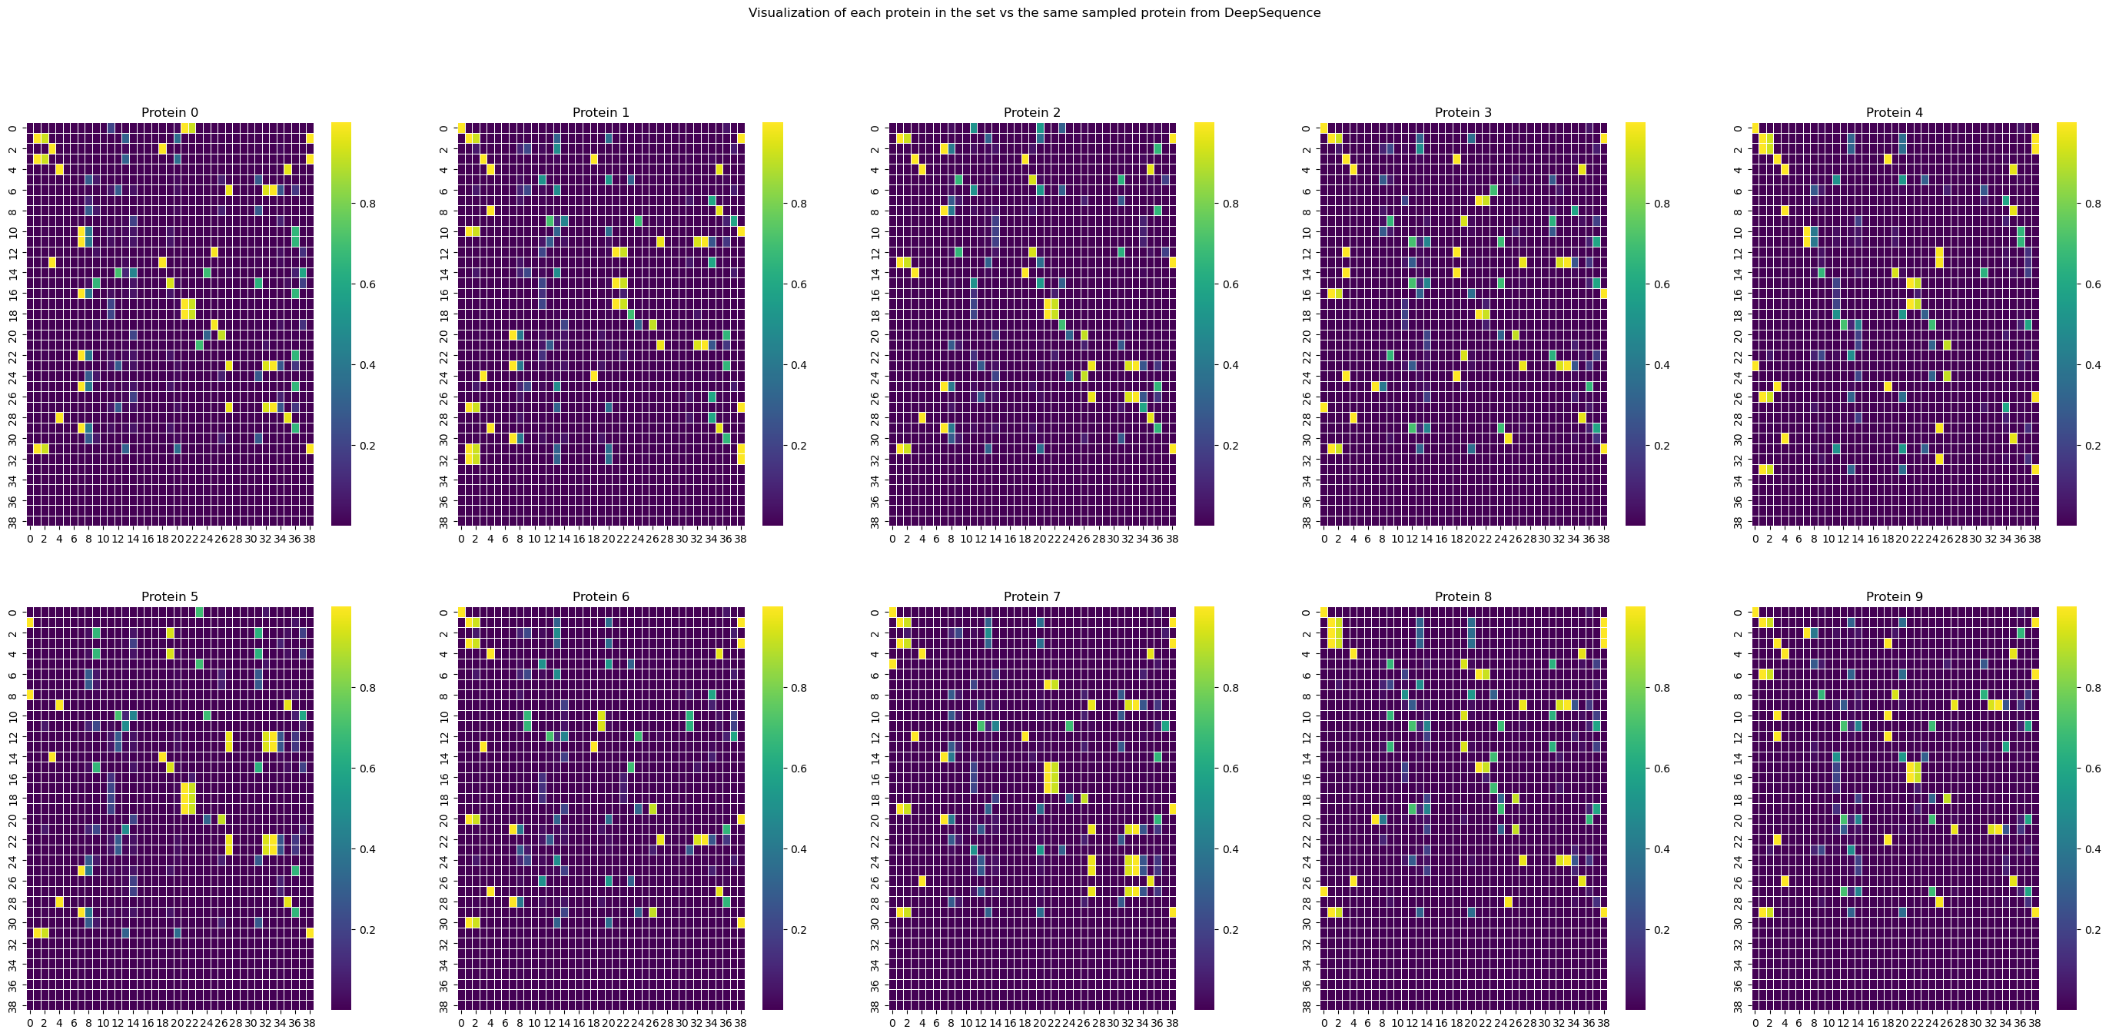
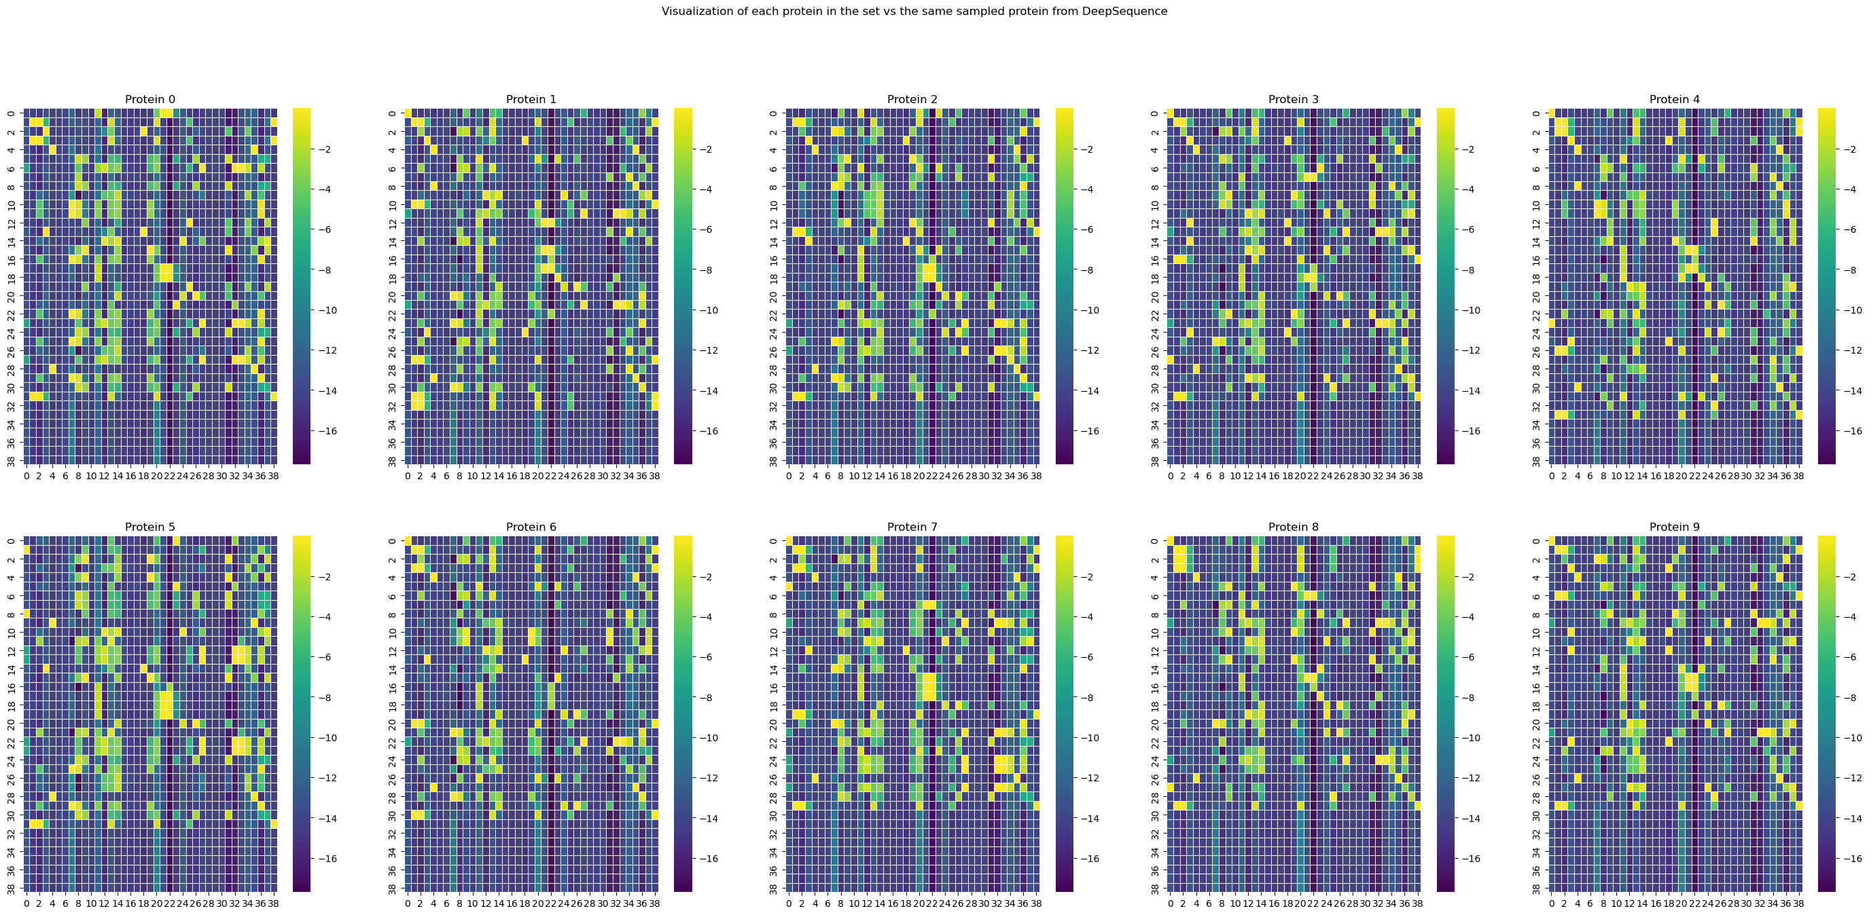

Slide 19
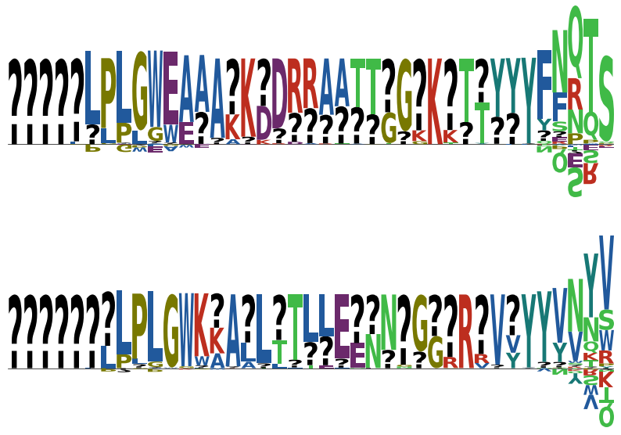
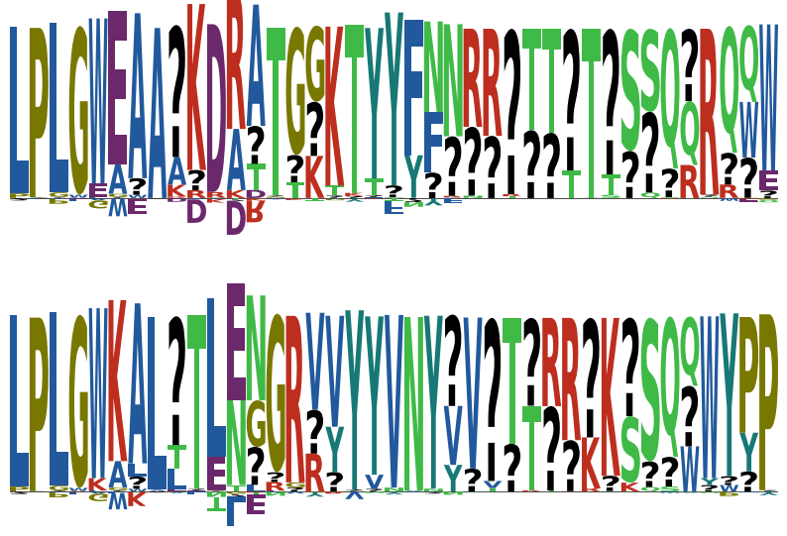
WITH NETWORK INITIALIZED AS DEFAULT (THETA OUTPUT NN)
WITH NETWORK INITIALIZED IN ZERO (THETA OUTPUT NN)

Slide 20
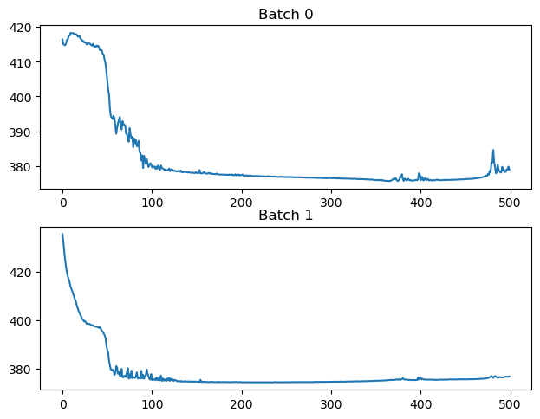
Prior definition over weights
So far it is working by setting up the wights in zero
Not sure how healthy would be to do that (risk of exploding gradients?)
Trying normal distributions:
N(0, 1e-3) and N(0, 1e-4): Colapse
N(0, 1e-5)
N(0, 1e-6)
WORKS!!!

Slide 21
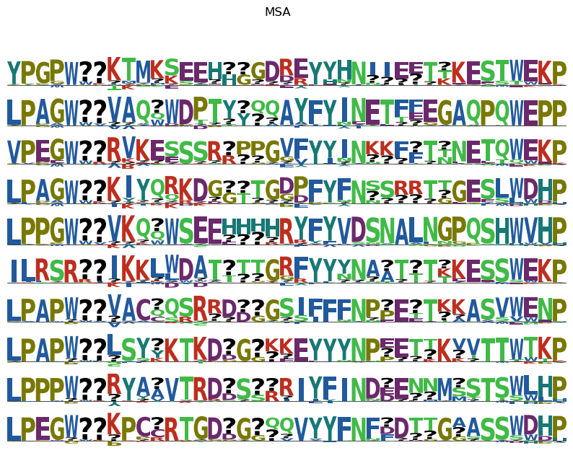
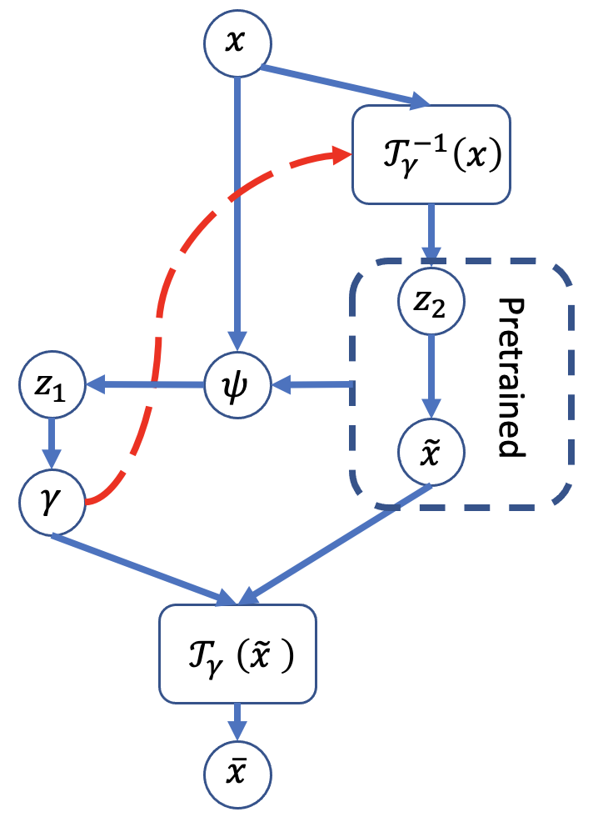
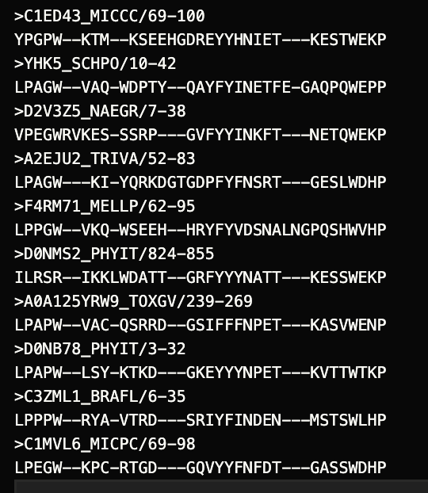
PGM
Real Alignment / Ground Truth
WHAT WE GOT!!!
Done it successfully
Almost Done
Try to fill the big gaps, but local minima limit shifting

Slide 22
